Slide 1

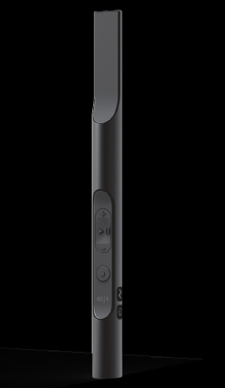
Project 4 – Team 1

Slide 2

Adrian Annaheim
Project manager
Benjamin Ebeling
Deputy project manager
Samuel Wey
Hardware
Andres Minder
Software
Jonas Rosenmund
Team member
Michael Schwarz
Team member

Slide 3
Content
Project targets
- Intended targets
- Desired targets
Test concept
- Total system
- Hardware
- Software
Hardware
- Memory
- Energy supply
Software
- Schematic
- Data flow
Question

Slide 4
Poject targets
Intended targets - Power supply with battery / charging with USB - Localisation per bluetooth - Sound over bone conduction - Operation according to design - Keep the budget of 200 CHF

Slide 5
Poject targets
Desired targets - Leave the design unchanged - Transmission the likes per software - Download the data and configuration per wireless - Headphone jack (3.5mm) - Battery life several hours - Access control for specific zones

Slide 6
Test Concept
Total system
Notes:
In the total system we try to simulate a museum with 3 Beacons to covering all scenarios
But it is easier to explain with a picture

Slide 7
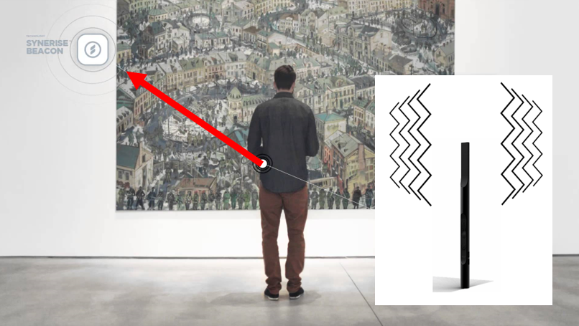
distance: 1 or 2m
Notes:
With the dojo in the hand you can walk to the desired object and with a distance of 1 or 2 metres the dojo tries to make a connection with the becaon and after a succesful connection the dojo vibrates and recognised the right beacon. Then the dojo is ready to play the informations or audiofiles. You click on the play button and hold the dojo to your skull.
The distance we calculate with the RSSI value (Received Signal strength indicator)

Slide 8
Test Concept
Hardware - Testing the individual components - Testing the charge
Software - Simulation of «Likes»
Notes:
During the whole developement phase, we always test individual components ,to make sure the component works. Moreover we test several charging and discharging cycles
With the Microcontroller we simulate the likes and send these to the computer

Slide 9
Hardware - memory
Assumptions
- 100 exhibition objects
- Sample rate of 44,1kHz
- Two languages stored on one Dojo
Results
- In average about 200 seconds per object
- Fast handling at the pay desk

Slide 10
Hardware – Energy supply
Assumptions
- Opening time of 10 hours
- Use of the Dojo during 1/3 of the time
Results
Battery with 800mAh
Capacity for a whole day
Minor changes of design (length / diameter)
Notes:
Now, Michael Schwarz will give you more information about our schematic and software.

Slide 12
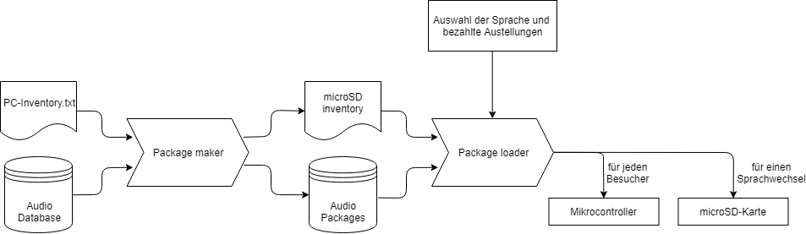

Slide 13

Questions

Slide 14
List of references
https://www.youtube.com/watch?v=s0QfpfGOrp8
https://www.geocaching.com/geocache/GC53CY7_fragezeichen-1?guid=7326435b-4db8-4e2f-9f65-292314b37c51
http://www.idownloadblog.com/2016/07/06/create-custom-vibration-text-messages-phone-calls-on-iphone/

